Slide 1
Allergic Rhinitis
Gregory Castelli, PharmD¹
Alexandria Taylor, PharmD²
University of Pittsburgh¹
UPMC St. Margaret FMRP²

Slide 2
Objectives
Identify allergic rhinitis definition, risk factors, and associated conditions.
Develop non-pharmacologic strategies to deal with allergic rhinitis including allergen avoidance.
Choose treatment for allergic rhinitis accounting for patient preference, cost, and side effects.
Apply treatment and education strategies to a patient case scenario.

Slide 3
Allergic Rhinitis
Final Jeopardy
Intro/Epi
H/P
Treatment 1
Treatment 2
10
10
10
10
20
20
20
20
30
30
30
30
40
40
40
40
50
50
50
50

Slide 4
Intro/Epi 10 Point Question
What is allergic rhinitis?
“An immunoglobulin E (IgE)-mediated inflammatory response of the nasal mucous membranes after exposure to inhaled allergens”
(Wallace et al., 2008)

Slide 5



IgE Antibody
Vesicle containing histamine
Mast Cell
Allergens bind to antibodies
Histamine released causing symptoms
Allergen enters respiratory system
Notes:
Picture from: http://biology-forums.com/index.php?action=gallery;sa=view;id=9235

Slide 6
Intro/Epi 20 Point Question
How is allergic rhinitis classified?
Seasonal, perennial, or episodic
- Or -
Intermittent, persistent, or episodic

Slide 7
Allergic Rhinitis Classification
Seasonal or intermittent
  Example: allergy to certain pollens
  Limitation is that it is dependent on geographic location and its climate for seasonal classification
  Seasonal means related to aeroallergens that are only present a certain portion of the year
  Intermittent classification = <4 days per week or <4 weeks per year
(Dykewicz et al., 2020; Wise et al., 2023)

Slide 8
Allergic Rhinitis Classification
Perennial or persistent
  Example: allergy to dust mites
  Perennial means related to year-round aeroallergens
  Persistent classification = >4 days per week or >4 weeks per year
Episodic
  unusual (for the particular patient) environmental exposures
  Example: visiting a home with a cat
(Dykewicz et al., 2020; Wise et al., 2023)
Notes:
By this classification in tropical settings patients may have year-round symptoms because the season never changes so offending pollen is present for much of the year. Thus treatment based on whether symptoms are intermittent, persistent, or episodic.

Slide 9
Intro/Epi 30 Point Question
How prevalent is allergic rhinitis in the US?
10%–30% of all adults and as many as 40% of children

Slide 10
Prevalence of Allergic Rhinitis
In the U.S.:
  Affects nearly 1 in 6 Americans; 10–30% adults self-report allergic rhinitis
  Most common chronic disease in children
  Fifth most common chronic disease in the U.S. overall
Increasing worldwide
(Dykewicz et al., 2020; Wise et al., 2023)

Slide 11
Intro/Epi 40 Point Question
What are non-clinical, yet patient-oriented outcomes of allergic rhinitis?
Direct costs (doctor visits, medications), indirect costs (loss of productivity, missed work days)

Slide 12
Economic Impact of Allergic Rhinitis
$2 to $5 billion dollars in direct health expenditures annually
23–33% report decrease in productivity when allergies were at their worst
Associated with increased asthma-related hospitalizations and higher total annual medical costs
(Dykewicz et al., 2020; Wise et al., 2023)
Notes:
Direct costs = office visits, treatments, medications, etc. Indirect costs = missed days of work and school, etc.

Slide 13
Economic Impact of Allergic Rhinitis
$2 to $4 billion in lost productivity annually
  Accounts for more loss of productivity than any other illness. (23% of all lost productivity)
  Study from Lamb et al., (2006) demonstrated average of 3.6 days absent per year due to allergic rhinitis in patients affected. (which was 55% of the patients in this study)
(Wallace et al., 2008)
Notes:
Direct costs = office visits, treatments, medications, etc. Indirect costs = missed days of work and school, etc.

Slide 14
Intro/Epi 50 Point Question
How does allergic rhinitis negatively affect quality of life? (at least 1)
Sleep disturbances, headaches, cognitive impairment

Slide 15
Allergic Rhinitis
Impact on Quality of Life
Sleep disturbance can lead to many of the impacts on quality of life.
Allergic rhinitis found to decrease quality of life overall but specifically contributes to:
  Fatigue
  Headache
  Decreased performance/cognitive impairment
(Dykewicz et al., 2020; Wise et al., 2023)
Notes:
Impact on overall functioning not often appreciated but can be significant (including irritability, decreased self-esteem particularly in younger patients)

Slide 16
H/P 10 Point Question
What are two risk factors for allergic rhinitis?
Family history, high IgE level, higher socioeconomic class, positive allergy (skin prick) testing

Slide 17
Risk Factors for Allergic Rhinitis
Family history = allergic rhinitis, urticaria, or asthma
20-year birth cohort study (Garbenhenrich et al) demonstrated following predictive factors –
  Parental history as per above
  Early allergic sensitization or eczema before age 3
  Birthday in summer or autumn
  Male sex
(Dykewicz et al., 2020; Wise et al., 2023)
Notes:
Summer or Autumn for study done in Germany, generally children born during respective country's allergy seasons are at higher risk. German study found higher IgE but not predictive (so maybe not true risk factor). Also, German study found no real link between SES and parental education level. Early allergic sensitization or eczema goes along with positive allergy testing as specifically positive skin prick testing.

Slide 18
H/P 20 Point Question
What are at least three symptoms suggestive of allergic rhinitis?
Exposure-associated or episodic rhinitis symptoms
(list on following slides)

Slide 19
Rhinitis Symptoms
Nose, eye, or mouth itching
Nasal congestion
Clear rhinorrhea
Sneezing
Post-nasal drip
Symptoms suggestive of other conditions
  Epistaxis, unilateral rhinorrhea or nasal blockage, anosmia, or severe headache
(Dykewicz et al., 2020; Wise et al., 2023)
Notes:
Symptoms in children particularly can also be fatigue or cough

Slide 20
Allergic Rhinitis History
Timing of symptoms important
  Duration longer than expected with URI
  Occur during certain time of year or in certain location
  Occur when around certain animals or plants
  Perennial allergic rhinitis can be harder to pick up initially given related to an aeroallergen that is always present
    Can inquire if symptoms less after changing air filter or with using air purifier
(Dykewicz et al., 2020; Wise et al., 2023)
Notes:
Symptoms in children particularly can also be fatigue or cough

Slide 21
H/P 30 Point Question
What other aspects of history are important beyond symptoms and timing? (name 2)
Family history, medications, co-existing conditions, occupational exposure, environmental history

Slide 22
Allergic Rhinitis
Expanded History
Family history as already mentioned is important due to increased risk if parent with allergic rhinitis, urticaria, or asthma.
Medications can impact patient’s symptoms (side effects that mimic rhinitis, effect that reduces allergic symptoms, etc.)
Co-existing conditions, including:
  Asthma (and age of onset)
  Eczema (and age of onset)
(Dykewicz et al., 2020; Wise et al., 2023)
Notes:
Medications include those that cause Rhinitis medicamentosa, blood pressure medications like ACEI, and antidepressants.
Asthma coexistent with allergic rhinitis impacts modifiable risk factors and treatment options. Eczema before age 3 already listed as risk factor for allergic rhinitis. Can go more in depth with occupational exposure and environmental history but these are just examples. Can expand based on what patient shares.

Slide 23
Allergic Rhinitis
Expanded History
Occupational exposure
  Chemicals
  Dust
  Animals
Environmental history
  Current and previous residence locations
  Pets (now and prior)
  Regularly visited locations
  (and animals/plants there)
(Dykewicz et al., 2020; Wise et al., 2023)

Slide 24
H/P 40 Point Question
What are four physical exam findings associated with allergic rhinitis?
List on following slides.

Slide 25
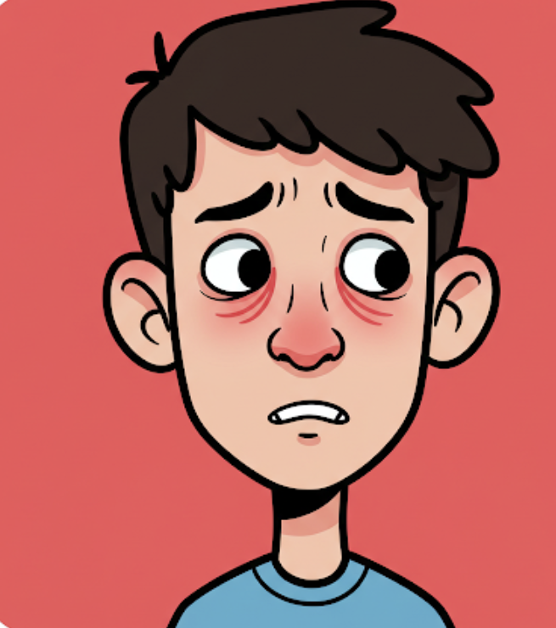
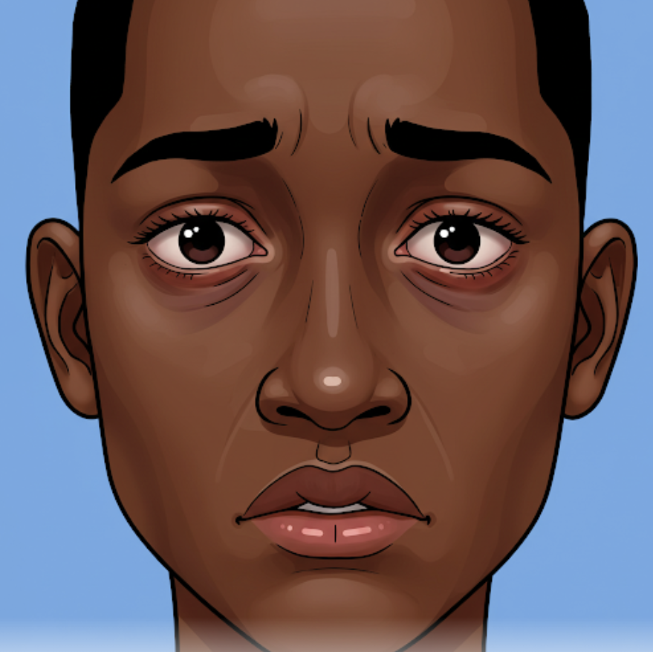
Allergic Rhinitis
Physical Exam Findings
General
  Mouth breathing
Eyes
  Watery eyes
  Redness and/or swelling of conjunctiva
  “Allergic shiners”–venous stasis below lower eyelids
  Dennie-Morgan lines–extra folds or lines below the eyes
Images created by Gemini (Google AI)
(Dykewicz et al., 2020; Wise et al., 2023)
Notes:
Gemini AI Generated images
Image created by Gemini (Google AI)

Slide 26
Allergic Rhinitis
Physical Exam Findings
Nose
  Transverse external crease
  Nasal turbinate hypertrophy
  Nasal turbinate pallor or erythema
  Clear nasal discharge
Oropharynx
  Halitosis
  Dental malocclusion or high arched palate
  (due to mouth breathing)
  Tonsillar hypertrophy
  Oropharyngeal cobblestoning
  Posterior pharyngeal postnasal drainage
(Dykewicz et al., 2020; Wise et al., 2023)
Notes:
Be sure to examine ears for signs of otitis, nose for nasal polyps, or suggestions of other causes (excoriation, prominent vessels, ulcers, perforation). Also check skin for signs of eczema.

Slide 27
H/P 50 Point Question
Two Part Question (must get both correct)
  What is one reason specific IgE testing may be useful for diagnosis?
  What is one reason specific IgE testing may not be warranted?
Support symptom diagnosis or allow target of specific allergen.
Cost, access, and cheap treatment options.
Notes:
Correct answer if they are able to provide single justification for why said yes or no.

Slide 28
Allergic Rhinitis IgE Testing
Helpful because:
  Can support that rhinitis symptoms are allergy-based versus other types of rhinitis (as affects treatment).
  Can confirm suspected causes of patient’s symptoms.
  Can help determine specific sensitivities to allow allergen avoidance or guide allergen immunotherapy (allergy shots).
(Dykewicz et al., 2020)

Slide 29
Allergic Rhinitis IgE Testing
Not helpful because:
  Empiric treatment should be attempted first.
  Best done by skin prick testing, which is not usually accessible in primary care offices.
  Needs to be guided by thorough history and knowledge of environment to guide which allergens are tested.

Slide 30
Treatment 1
10 Point Question
What is the most effective class of medications for treating allergic rhinitis?
Intranasal Corticosteroids
Notes:
Review product slide, note which products are OTC, number of sprays needed and frequency of use. Stress that all of these products should be used in each nostril.

Slide 31
Intranasal Corticosteroids
Relieve sneezing, rhinorrhea, pruritus, and nasal congestion.
Reduce inflammation, suppress neutrophils, cause mild vasoconstriction.
Available in generic formulations and over-the-counter options.
(Dykewicz et al., 2020; Wise et al., 2023)

Slide 32
Common Products and Doses
Product Name | OTC | Dose | Directions
Beclomethasone (Beconase AQ®) |  | 42 mcg | 1–2 sprays BID
Budesonide (Rhinocort®) | X | 32 mcg | 1–4 sprays daily
Ciclesonide (Omnaris®) |  | 50 mcg | 2 sprays daily
Flunisolide (Nasarel®) |  | 25 mcg | 2 sprays 2–3 times daily
Fluticasone furoate (Veramyst® Flonase Sensimist®) | X (FS) | 27.5 mcg | 2 sprays daily
Fluticasone propionate (Flonase®) | X | 50 mcg | 1–2 sprays daily
Mometasone furoate (Nasonex®) |  | 50 mcg | 2 sprays daily
Triamcinolone acetonide (Nasacort®) | X | 55 mcg | 1–2 sprays daily
All should be used in EACH nostril.
Lexicomp Online. Copyright© 1978-2025 Lexicomp, Inc. All Rights Reserved.
Notes:
Review product slide, note which products are OTC, number of sprays needed and frequency of use. Stress that all of these products should be used in each nostril.
Appropriate age ranges vary by product.

Slide 33
Intranasal Corticosteroids:
2017 Update
For initial treatment, routinely prescribe intranasal corticosteroids as monotherapy.
For the treatment of moderate to severe allergic rhinitis, the clinician may recommend the combination of intranasal corticosteroids and intranasal antihistamines for initial treatment.
(Wallace et al., 2017)

Slide 34
Treatment 1
20 Point Question
How long does it take for a peak response to occur for intranasal corticosteroids in most patients?
2 weeks
Notes:
While these products can start working after one use, the max benefit can take a couple weeks. Antihistamines offer an advantage here because they can start working after one dose. However, intranasal products are the most effective agents per the guidelines.

Slide 35
Onset of Effect
Intranasal corticosteroids will start working in 3–12 hours.
However, maximum effect is realized over 2 weeks.
As needed regimens can also control seasonal allergies but may not be as effective as continual use.
(Wallace et al., 2008; Wells et al., 2015)
Notes:
While these products can start working after one use, the max benefit can take a couple weeks. Antihistamines offer an advantage here because they can start working after one dose. However, intranasal products are the most effective agents per the guidelines.

Slide 36
Treatment 1
30 Point Question
What are three common side effects of intranasal corticosteroids?
Sneezing, stinging, headache, epistaxis, rare infections with Candida albicans
Notes:
Team only needs to have three. Important to note that these side effects are common. Systemic absorption is minimal does not cause any effects.

Slide 37
Intranasal Corticosteroid
Side Effects
When recommended doses are used, the below systemic effects have not been seen:
  Childhood growth suppression
  Cataracts
  Glaucoma
  Hypothalamic-pituitary-adrenal (HPA) axis
(Wallace et al., 2008; Wells et al., 2015)

Slide 38
Treatment 1
40 Point Question
What are two educational points to give to patients about how to use an intranasal corticosteroid device?
Shake bottle, prime device, blow nose prior to use, close one nostril, aim 45° angle

Slide 39


Proper Technique Video
Notes:
Please show video. If embedded video does not play, click on camera to open video in web browser.
http://youtu.be/oEzEvbBRwHo

Slide 40
Treatment 1
50 Point Question
What is the youngest age intranasal corticosteroids are indicated?
2 years old
Depends on which
product you choose

Slide 41
Pediatric Considerations
Product Name | Age (years)
Beclomethasone (Beconase AQ®, Qnasl®) | 6, 4
Budesonide (Rhinocort®) | 6
Ciclesonide (Omnaris®) | 6
Flunisolide (Nasarel®) | 6
Fluticasone furonate (Veramyst® Flonase Sensimist®) | 2
Fluticasone propionate (Flonase®) | 4
Mometasone furoate (Nasonex®) | 2
Triamcinolone acetonide (Nasacort®) | 2
Lexicomp Online. Copyright© 1978-2025 Lexicomp, Inc. All Rights Reserved.
Notes:
Important to note that neither of the OTC products (Nasacort and Flonase) can be used at 2. Flonase can be prescribed at age of 4.

Slide 42
Treatment 2
10 Point Question
Name the second-generation antihistamines (five total).
Loratadine (Claritin®, Allovert®) Desloratadine (Clarinex®) Fexofenadine (Allegra®)
Cetirizine (Zyrtec®)
Levocetirizine (Xyzal®)

Slide 43
Oral Antihistamines
Product Name | Adult Dose | Children Dose
Loratadine (Claritin® Allavert®) | 10 mg daily | 2–5 years: 5 mg daily ≥6 years: 10 mg daily
Desloratadine (Clarinex®) | 5 mg daily | 6–11 months: 1 mg daily 1–5 years: 1.25 mg daily 6–11 years: 2.5 mg daily ≥12 years: 5 mg daily
Fexofenadine (Allegra®) | 60 mg BID or 180 mg daily | 6–11 years: 30 mg BID
Cetirizine (Zyrtec®) | 10 mg daily | 1–5 years: 2.5 mg daily ≥6 years: 5 mg dialy
Levocetirizine (Xyzal®) | 5 mg QPM | 6–11 years: 2.5 mg QPM
(Sur et al., 2010; Wells et al., 2015)
Notes:
Review the differences between pediatric and adult doses. Note that not all can be used safely in pediatric patients and that desloratadine can be used earliest in life.

Slide 44
Oral Antihistamines
Histamine receptor antagonists.
Anticholinergic effect may also aid in mechanism of action.
  Caution in select patients.
Second generation are peripherally selective.
  Can still be sedating.
(Sur et al., 2010; Wells et al., 2015)

Slide 45
Treatment 2
20 Point Question
How do medications like montelukast (Singulair®) work?
Selective leukotriene receptor antagonist

Slide 46
Selective Leukotriene Receptor Antagonist
Montelukast only LTRA indicated for allergies
Can be used as young as 6 months for rhinitis
Considered third line option
  Behind intranasal steroids and antihistamines
(Merck, 2012)
Notes:
Should not routinely be thought of first line. May be beneficial in someone with asthma. There are different formulations depending on pediatric age.

Slide 47
Montelukast
Children dosing:
  Children 6 months to <2 years:
  4 mg (oral granules) once daily
  Children ≥2 to <6 years: 4 mg (chewable tablet or oral granules) once daily
  Children ≥6 years and adolescents <15 years: 5 mg (chewable tablet) once daily
  Adolescents ≥15 years: 10 mg once daily
(Merck, 2012)
Notes:
Should not routinely be thought of first line. May be beneficial in someone with asthma. There are different formulations depending on pediatric age.

Slide 48
Treatment 2
30 Point Question
Two-part question (must get both right)
  Which has the most sedation potential?
    Cetirizine, Chlorpheniramine, Diphenhydramine
  Which has the most anticholinergic potential?
    Cetirizine, Chlorpheniramine, Diphenhydramine
Diphenhydramine
Diphenhydramine

Slide 49
Antihistamines
Nonselective or first generation
  Tend to be more sedating
    Due to lipid solubility allow BBB passage
  Tend to have more anticholinergic properties
Generally, not used for allergic rhinitis due to side effect profile
( Wells et al., 2015)
Notes:
First generation products tend to have much more antihistamine/anticholinergic properties. Chlorpheniramine is a first generation product that has fewer of these than others. In general, second generation products are preferred for management of allergic rhinitis over first generation.

Slide 50
Antihistamines
Product Name | Sedative Effect | Anticholinergic Effect
Diphenhydramine | +++ | +++
Chlorpheniramine | + | ++
Promethazine | +++ | +++
Cetirizine | +/- | +/-
( Wells et al., 2015)
Notes:
First generation products tend to have much more antihistamine/anticholinergic properties. Chlorpheniramine is a first generation product that has fewer of these than others. In general, second generation products are preferred for management of allergic rhinitis over first generation.

Slide 51
Treatment 2
40 Point Question
Which product(s) has monthly purchase quantity restrictions?
    Phenylephrine
    Pseudoephedrine
    Both
B. Pseudoephedrine

Slide 52
Oral Decongestants
Slower onset of action than topical
Doses up to 180 mg should not affect blood pressure and heart rate
Avoid in patients with hypertension
Can cause CNS stimulation
Many combination products with antihistamines
  Provides dual mechanisms
(Sur et al., 2010; Wells et al., 2015)
Notes:
Dual products helpful. Not absolute contraindication for some with hypertension but is at goal. Use in these patients should be strongly debated however. Coricidin products are marketed as decongestants for patients with hypertension. These products usually contain a first generation antihistamine. Use Coricidin products in caution in our elderly patients.

Slide 53
Topical Decongestants
Product Name | Duration
Short-acting
Phenylephrine | Up to 4 hours
Intermediate-acting
Naphazoline | 4–6 hours
Tetrahydrozoline | 4–6 hours
Long-acting
Oxymetazoline | Up to 12 hours
Xylometazoline | Up to 12 hours
(Wallace et al., 2008; Wells et al., 2015)

Slide 54
Topical Decongestants
Stimulates adrenergic receptors in nasal mucosa to produce vasoconstriction.
Should not be used longer than 3 days.
  Rhinitis medicamentosa
  Not seen with oral agents
Caution also in:
  Cardiovascular disease
  Hyperthyroidism
(Sur et al., 2010; Wells et al., 2015)
Notes:
The 3 day limit is an important patient education piece.

Slide 55
Treatment 2
50 Point Question
What is an example of an intranasal antihistamine?
Azelastine
(1-2 sprays once or twice daily)
Notes:
The 3 day limit is an important patient education piece.

Slide 56
Azelastine
Inhibits histamine at H1 sites, decreasing allergic response
Onset of action 15–30 minutes and lasts for 12 hours
  Faster onset than oral antihistamines (1–3 hrs)
May cause bitter taste
Similar side effect profile to oral antihistamines
(Dykewicz et al., 2020; Wise et al., 2023)

Slide 57
Azelastine
Recommended as a first line option:
  Seasonal allergic rhinitis
  Non-allergic rhinitis
  Intermittent allergic rhinitis
Intranasal corticosteroids still preferred in persistent rhinitis and also for moderate/severe symptoms
(Dykewicz et al., 2020; Wise et al., 2023)

Slide 58
Final Jeopardy:
Patient Case
Write down how much you would like to wager.

Slide 59
Final Jeopardy Question
MC is a 5-year-old female who presents for evaluation. PMH of eczema. Few month history of itchy eyes, runny nose, sneezing, and headaches. It is spring, although she has never had seasonal allergies. Her family adopted a kitten around the same time her symptoms started. The family admits that the kitten sleeps in MC’s room. Her mom was diagnosed with allergic rhinitis when she was younger. For her symptoms, MC has been taking cetirizine 5 mg every evening for 2 months and topical phenylephrine for 1 week.

Slide 60
Questions
?

